Slide 1
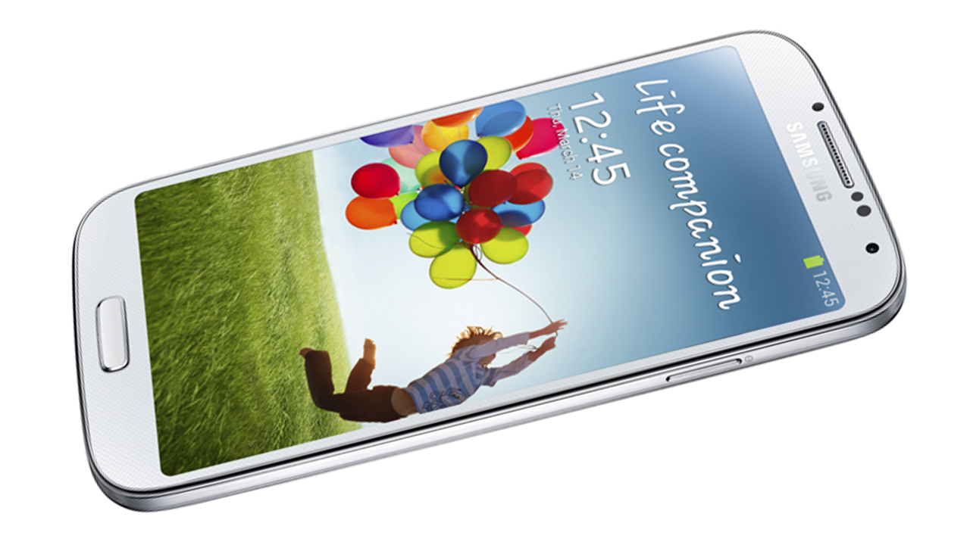
Notes:
This is Samsung Galaxy S4. The best 2013 cellphone that attractive like a blackhole as the feature
Life compainion

Slide 2
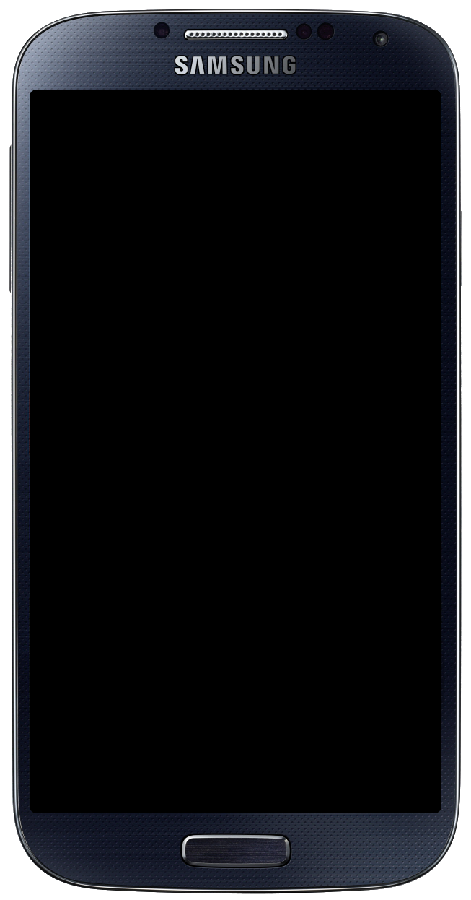
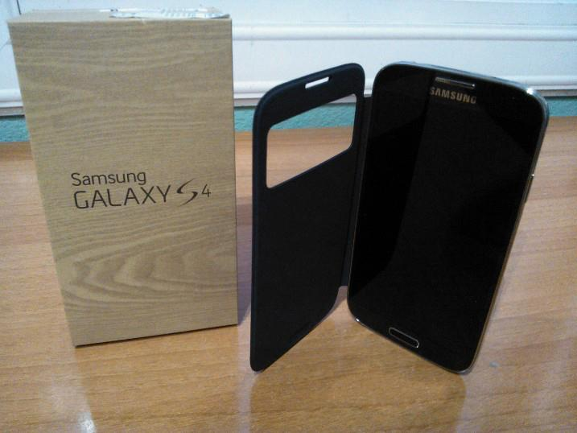
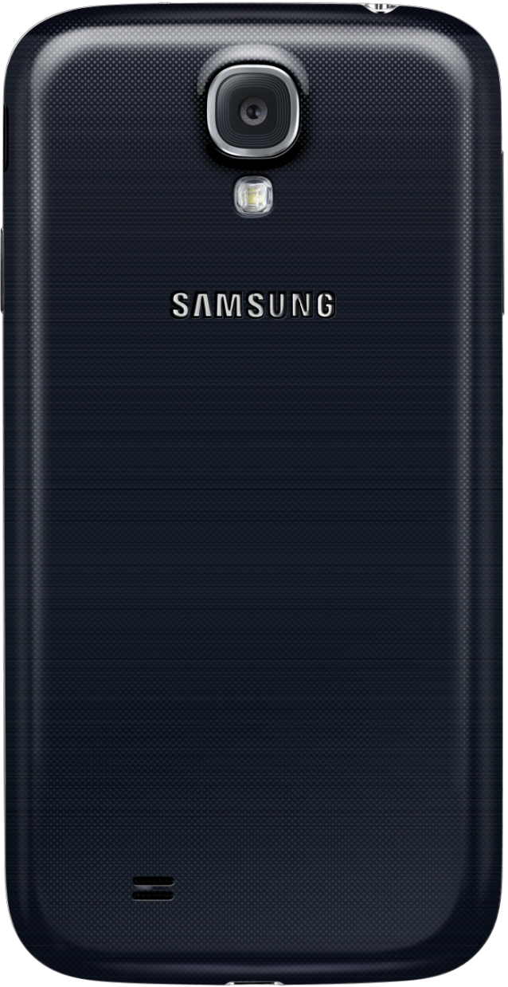
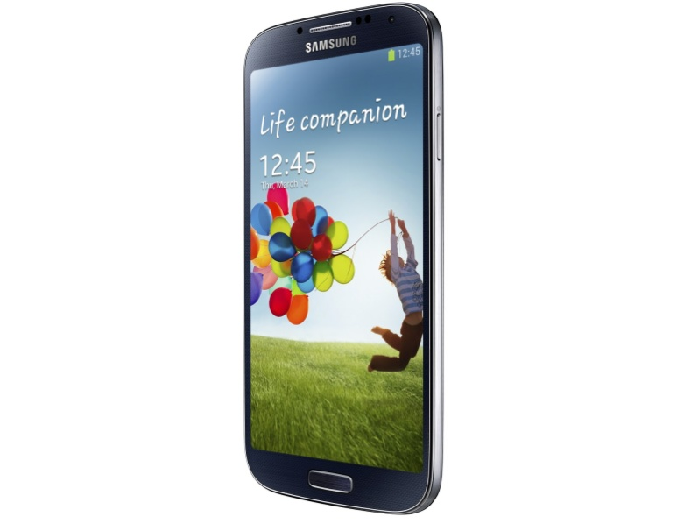
Notes:
View of Galaxy S4

Slide 3
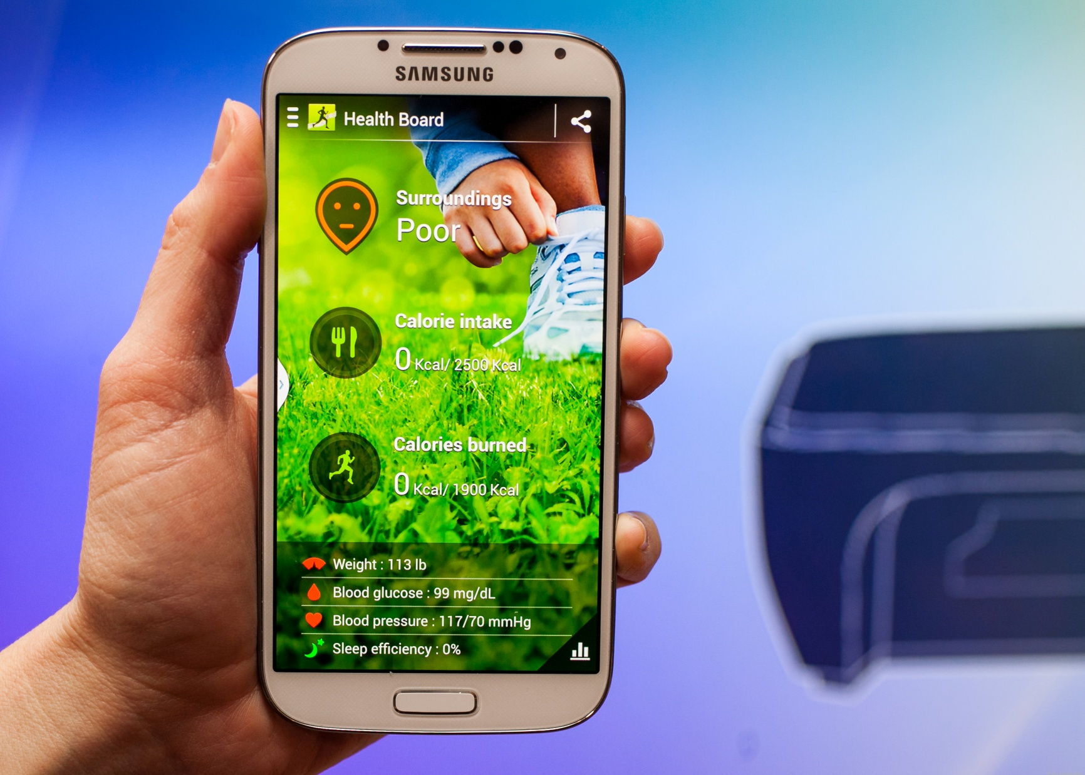
Notes:
Samsung Galaxy S4, has built with Health Board (Health app) to track your Calories in and out AND also can sync with compatible accessories like a fittness band and heart monitor

Slide 4
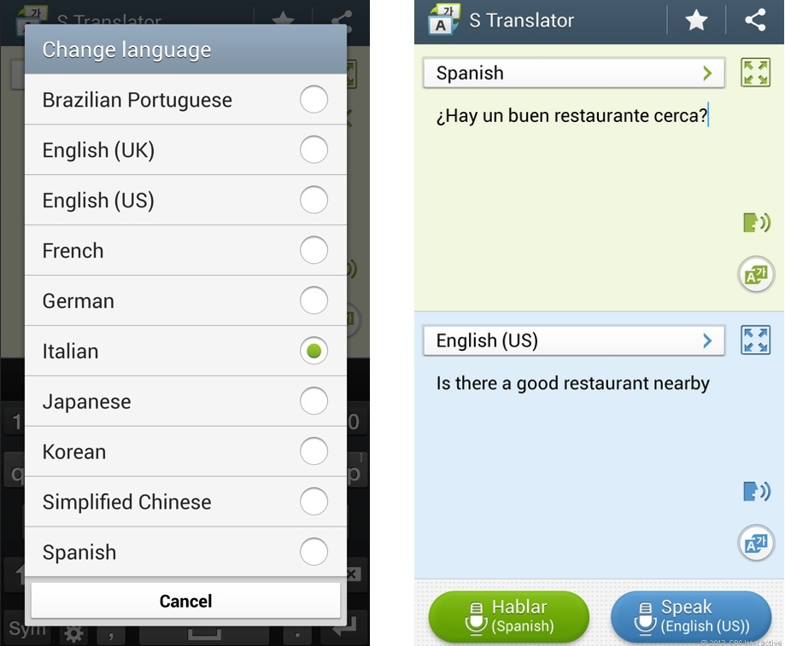
Notes:
This is the best part ever! Galaxy S4 has built respectly with their translator machine called, S translator. This tool can translate every speak available on this tool. Also more of the best is, it also recognize your voice, so the output vocal will be similarly. E.g. you speak *your language* input to your device, then the device will automaticly set the voicing pitch, breathiness, etc., as the best as possible, so the output will sound with similar voice, to help you speak emergencyly.
Guess what? Never feel stranded and NEVER be Forever alone a huge part of this world

Slide 5
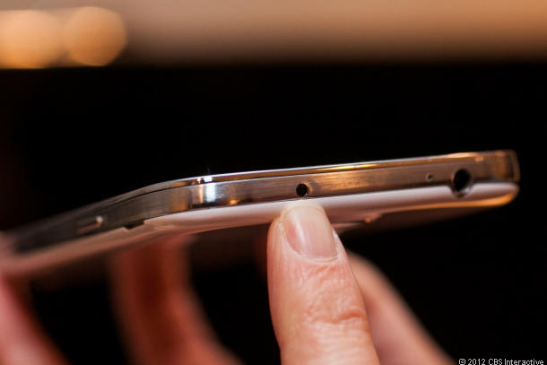
Notes:
Some of you had already bought your own Galaxy S4. but most of you noticed a strange translusen gray dot on top beside the headset port. Did you know that dot is the Infrared light. This IR already back supported in this Samsung Galaxy S4. But not what you expect like transfering file (if never app there), but instead of controlling. You know it is Remote control. The app is built in, it is used to controll your Samsung SMART TV, but also controll every IR supported device like other TV, DVR, DVD. Just that what they can do but If there was a custom made app about this IR light, we could to do everything such as transferring file, controll everything tape, AC, machine, fan, PC, etc. For the future.

Slide 6
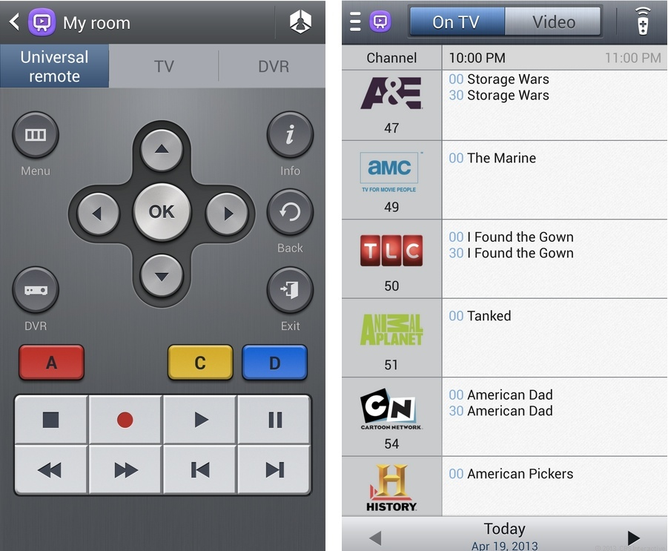
Notes:
Lets next to detail about IR remote called, Watch on. Especially used to controll every Samsung SMART devices such as TV. But can also to control every other TV, DVR. So I told you, if you had already bought Galaxy S4, you’re in luck for some people, because if your included remote LOST, you don’t have to buy universal remote. Simply prepare your Galaxy S4 and setup to your device and there you go. Also if you are lazy, you can set to put the controll on the notification and also lock screen for extreme emergency.

Slide 7
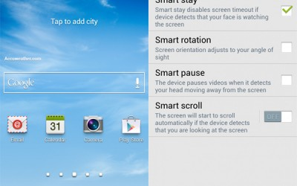
Notes:
Samsung Galaxy S4, has built with these SMART feature: Stay, Rotate by sight, Pause, scroll

Slide 8
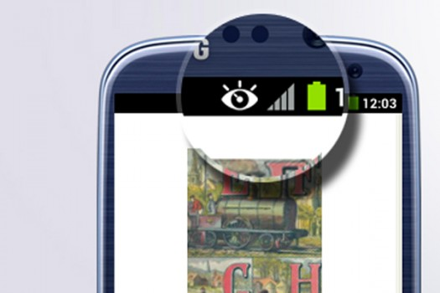
Notes:
Smart Stay: this feature already applied since S3 age. But it suck as the front camera, so you have to look very-very straight to keep device from sleeping. This will cause fatigue of you eyes, dryed eye, and instant asleep. But now Samsung Galaxy S4 just got better. With 2 MP, Samsung improve to also Smart stay, so you don’t have to look so very straight, just looking at the display, is enough recognition to keep it stay. As you can see on your Galaxy S4, you’ll always see the eye logo, that is the smart stay is working along you see the display.

Slide 9
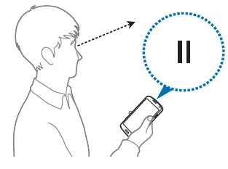
Notes:
Never lose anything, that is Smart Pause. Smart Pause is the action of your Galaxy S4, to pause when you look away from display. Since Galaxy S4 look your eyes activity to do Smart Stay, it also look yours to do Smart Pause. So, e.g. Your friend calls you then you interupted. You should lose every world’s important part of your moment, but you had a luck once more, that is Smart Pause. You just have to look out then the video will be paused automaticly. This feature is extremly important for who often interupted by your foes.

Slide 10
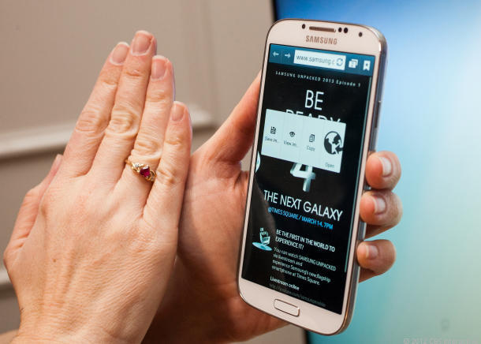
Notes:
After seeing your face activity, this S4 can see a motion like a swipe. This swipe is for to do a Smart Scroll. Smart Scroll is the feature to Swipe to navigate through the page. This feature is very important for who had a syndrome that swiping up to scratching an object will destroy their part (Weak DNA Syndrome). Also Smart Scroll is available too on eye tracking way by looking at the edge of the screen to scroll. Very important to who had a worse syndrome that is moving your limb will destroy everything (stay syndrome), or alternative for who had Weak DNA syndrome.

Slide 11
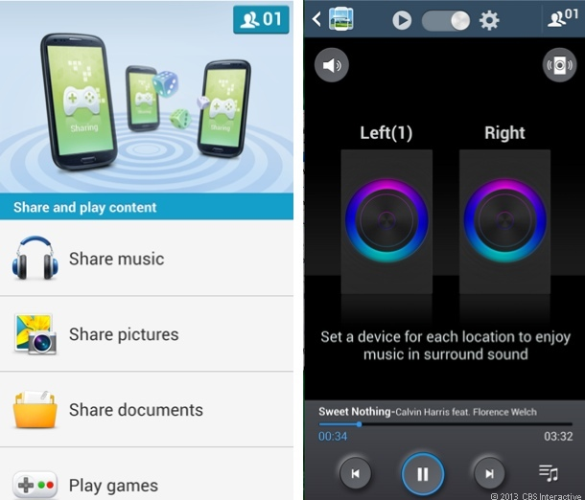
Notes:
So Thats all we can look. Next is the Group play. We call this S-IGNAL (read: S signal). This feature will make everyybody jealous and feel being racisted. Why? This Group play doesn’t require anything that is famous conection like Bluetooth, Wi-fi, NFC, 3G or either 4G internet. That is exclusive conection starting from Galaxy S4. So, What can you do in this App? You can Share a music to sync each other’s Galaxy S4 so they will work like a stereo speaker. You can Share a Picture, Share a Document without any resistor. Play the supported Games Multiplayer at once, at the same time without internet! Just S-IGNAL simply. This feature is Zetta important for who are living in a village that the most had no 3G or 4G either, also Zetta important for who had no much money more to buy a speaker, console (now in 2026 simply PC), or everything else. Important for who had a crush with the famous connection like Bluetooth, internet 4G or 3G, NFC, except newly S-IGNAL.

Slide 12
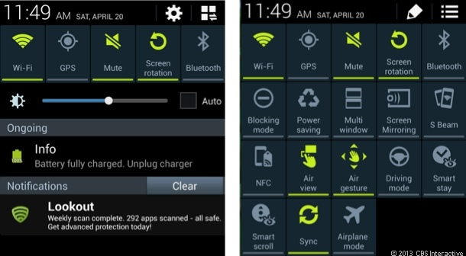
Notes:
This is Notification. Now in Android 4.2 had a separate shade. So, I tell you before you angry, that is not an error. but seperated function of the shade. On your tablet with Android 4.2 like Nexus, you used to swipe on top left to open notification and top right to open Switch shade. But in S4 each time you open the Shade, you’ll see the icon on the very top right. Press that button to Switch room between Notification room or Switch room. Why there are seperate? Since more feature implemented to this Galaxy, and the Android update, so the function change. On the switch in notification room, maybe you can’t swipe. Instead by click on very top right icon for more switch. And click again to go back to Notification room.

Slide 13
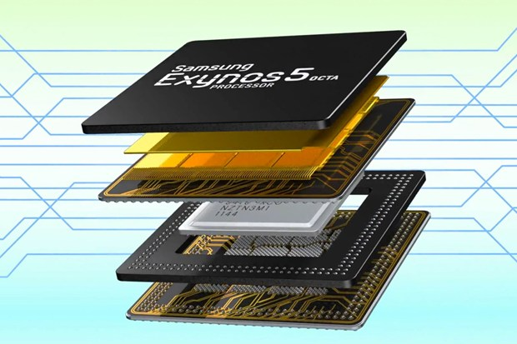
Notes:
So what all behind this? How could it does all of these extremes? Is the CPU. The CPU of this Galaxy S4 powered with Exynos 5 octa-core! The first Phone with 8 Core of the CPU! You can play extreme game like Angry Birds, Apparatus, etc. WITHOUT ANY LAG!!!!!! Extremly Zetta important for who are angry up to rage to all of those lags and even hang and crash.

Slide 14
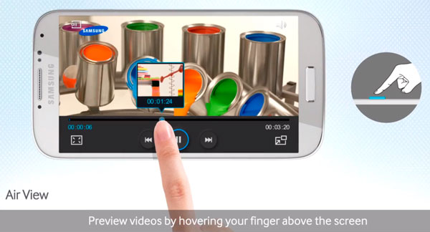
Notes:
Hover Touch. This feature is starting to same with the computer. Simply float your finger above your screen is as same as you putting the cursor on the button. Such as Air View. Hovering the finger above the seek will preview the time of that movie. Like YouTube. Stock Android doesn’t support hover touch yet as you can see on Android PC. Only on Samsung Galaxy S4. Just imagine, if you install Ubuntu there, sometime you see an Arrow cursor moving on as the position of your finger, or Windows instead. If you want to test, go ahead to Call app, press *#0*# then select “TSP Hovering”, There. Hover your finger above the Box on that screen ‘til all boxes are green-ed then you’ll see “PASS”. That mean Hover touch is working max properly.

Slide 15
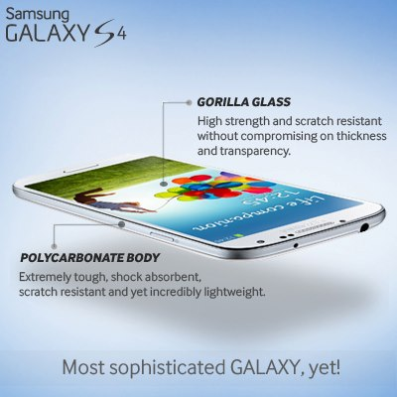
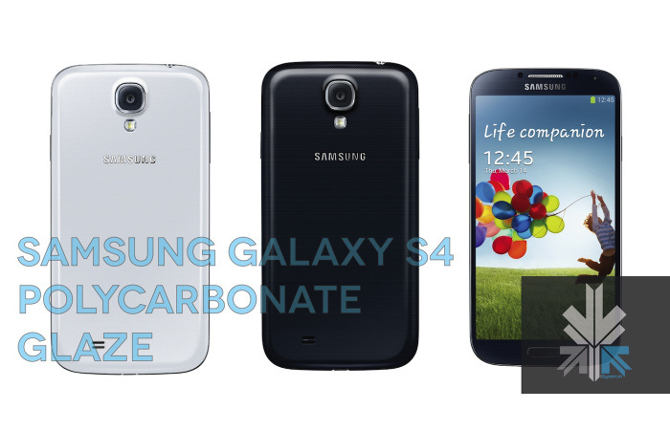
Notes:
Polycarbonate body

Slide 16
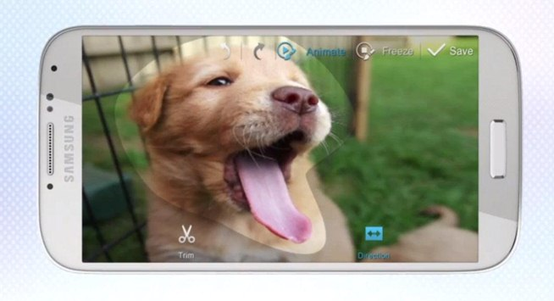
Notes:
Sound And shot!

Slide 17
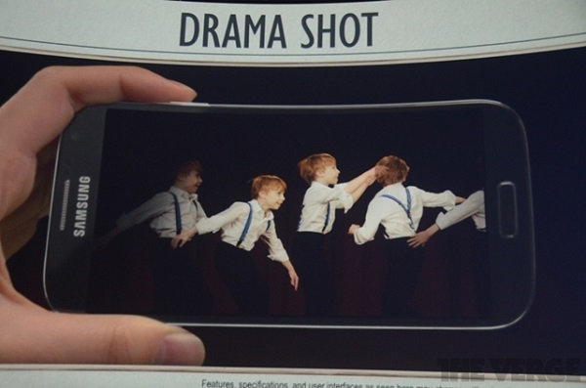
Notes:
Drama Shot

Slide 18
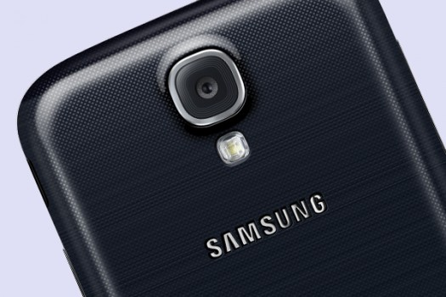
Notes:
Camera 13 MP

Slide 19
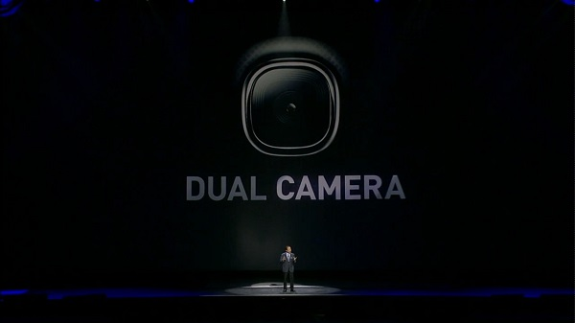
Notes:
Samsung Dual Camera
Front 2 MP
Back 13 MP

